Slide 1
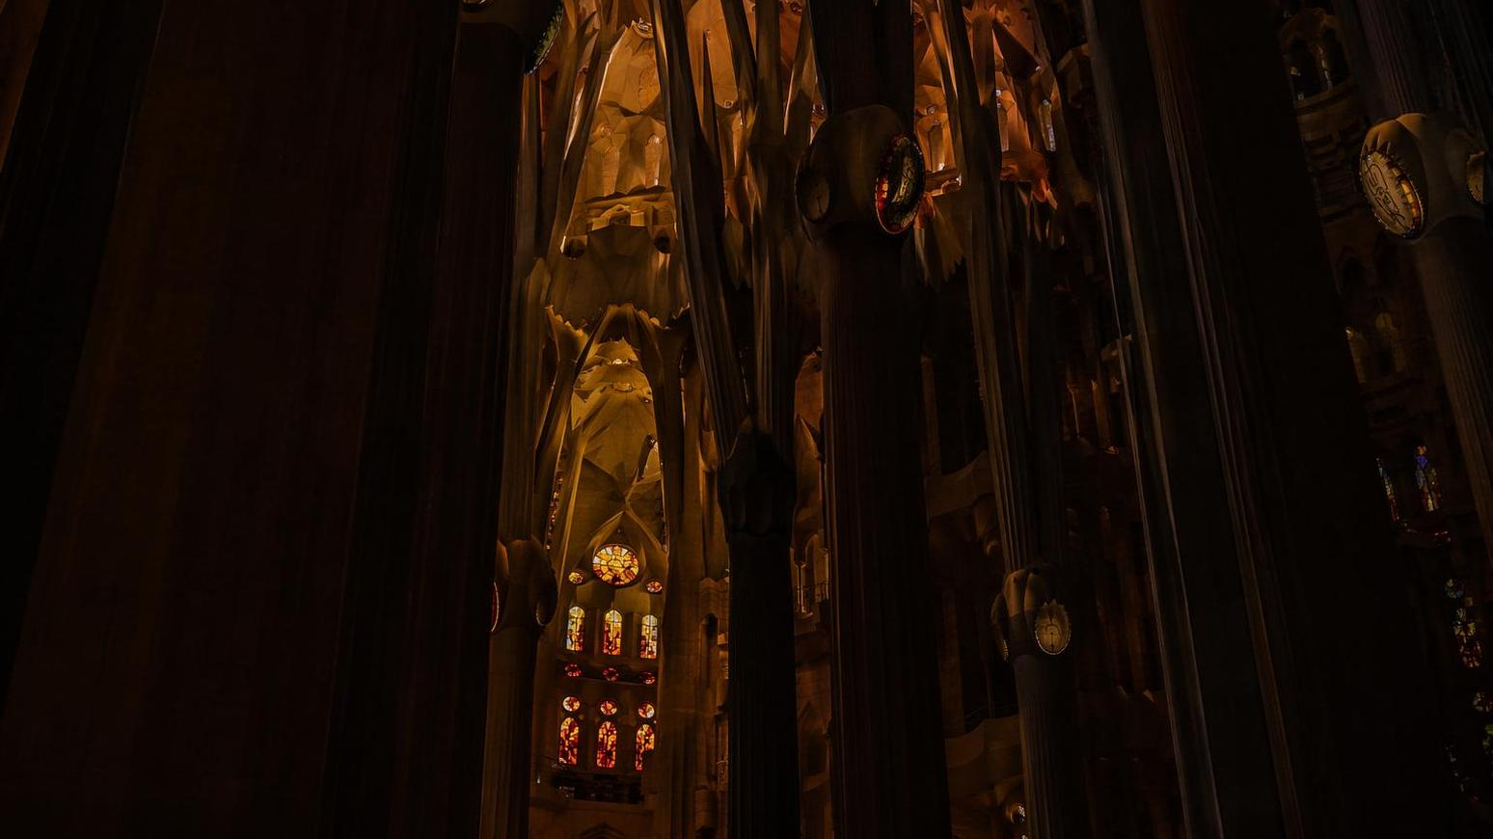
Barcelona AI & Data
(BAD) Inaugural Meetup
Subru Krishnan, Principal Architect (Microsoft), Apache PMC (Hadoop/YuniKorn)
Join the community shaping Barcelona's AI and Data ecosystem
Barcelona · 2026

Slide 2



Our Mission
Building the community where Barcelona’s academia, startups, and enterprises shape the cloud and data future for AI— together.
Academia
Startups
Enterprises

Slide 3
Guiding Principles
01
Ecosystem-First
02
Depth Over Hype
Open participation and technical content. No gatekeeping — everyone is welcome.
Real systems, real deployments, real benchmarks. No buzzword bingo here.
03
Lifecycle-Oriented
04
Neutral Stewardship
From research to runtime operations. We cover the full journey.
Rotating hosts handle logistics. Content stays community-driven.

Slide 4






Focus Areas
AI-native large-scale cloud data systems
Distributed
Processing
Cloud Data
Infrastructure
Database and Graph
Engines
Large-scale analytics platforms
Warehouses and open ecosystems
Next-gen storage engines
Intelligent
Systems
AI-Ready
Platform
AI Models and
Frameworks
Full lifecycle in production
Native support for Agentic clients
Training and inference at scale

Slide 5




Event Formats
Talks and Q&A
Hands-On Workshops
Lightning talks, deep dives, and live Q&A with speakers
Runtime optimization, self-healing systems, AI-first development
Panels and Discussions
Shape Our Future Together
Community-driven debates on the topics that matter
Bring your ideas and energy — together we define what comes next

Slide 6




Call to Action
Here’s how to get involved
Host the Next Iteration
Volunteer your company or university as the next venue
Become a Speaker
Present a lightning talk, deep dive, or join a panel
Website Manager
Help build and maintain our online presence
Communication Tools
Stay connected via Teams, Slack, or Mattermost
Let’s build this together.

